Slide 1
Final Capstone Project
Mapping Crime in SAN Francisco
By James Njumwa

Slide 2
Executive Summary
Project entails mapping of crime incidences in San Francisco in 2016
Increased crime rates prompted the need to evaluate most susceptible areas in San Francisco.
Data upload in csv format and data exploratory analysis done to provide descriptive analysis.
In-depth analysis conducted using clustering and mapping using cluster markers and drop pins.
Tyler street highlighted as the most susceptible area including its neighbourhood.
Further robust analysis recommended for more inferential statistics.

Slide 3
Introduction
The final course of the Data Science Professional Certificate consists of a capstone project in which all of the skills and related details gained over the nine rigorous coursework must be implemented on a final project.
In this project we explore the San Francisco police department incidents using cluster visualization to map out number of crimes in San Francisco.

Slide 4
Problem statement
In any developed or developing countries, there exists a marginal gap between the rich and the poor. Based on increased rates of unemployment, the ever growing population tends to lose its moral value and engage in crimes just to overcome the social burdens they are facing individually.
In 2016, the police department of San Francisco Made numerous arrests include major and minor. This issue rendered the necessity to understand the patterns of criminal behaviors in the state.

Slide 5
Data Preparation
Data was downloaded and imported into pandas as a csv file. Imported data consisted of 13 variables including longitude and latitude values of crime locations.
The descriptive analysis indicated that there were a total of 150,500 crimes that were reported in San Francisco in 2016.
The study randomly selected a limit of 100 crimes to work as a representative of the population.

Slide 6
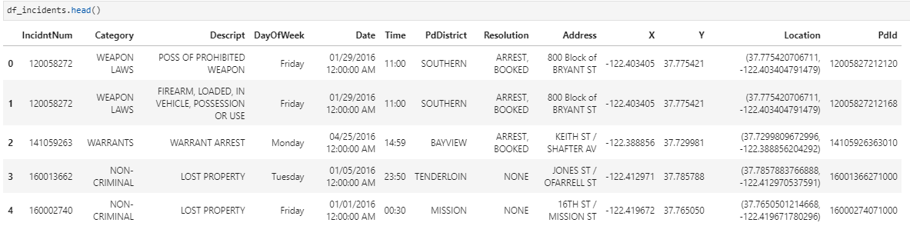
Variables Used

Slide 7
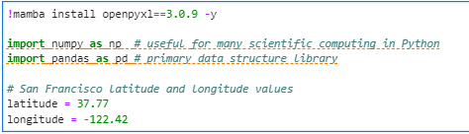
Methodology
Data Clustering and mapping was employed in the study after cleaning and sorting the imported data.
The necessary features including folium maps, mamba, numpy, and pandas were installed with their plugins.

Slide 8
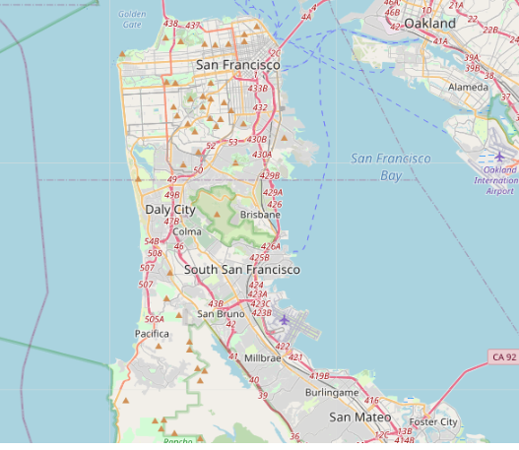
Study area

Slide 9
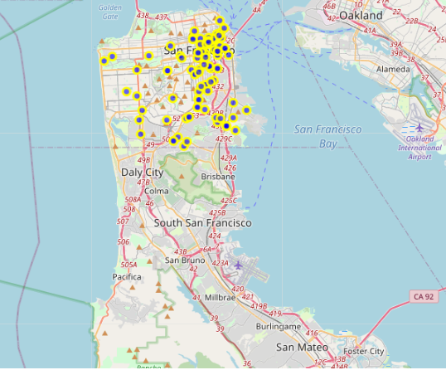
Superimposed crime locations on the map using folium to create a feature group

Slide 10
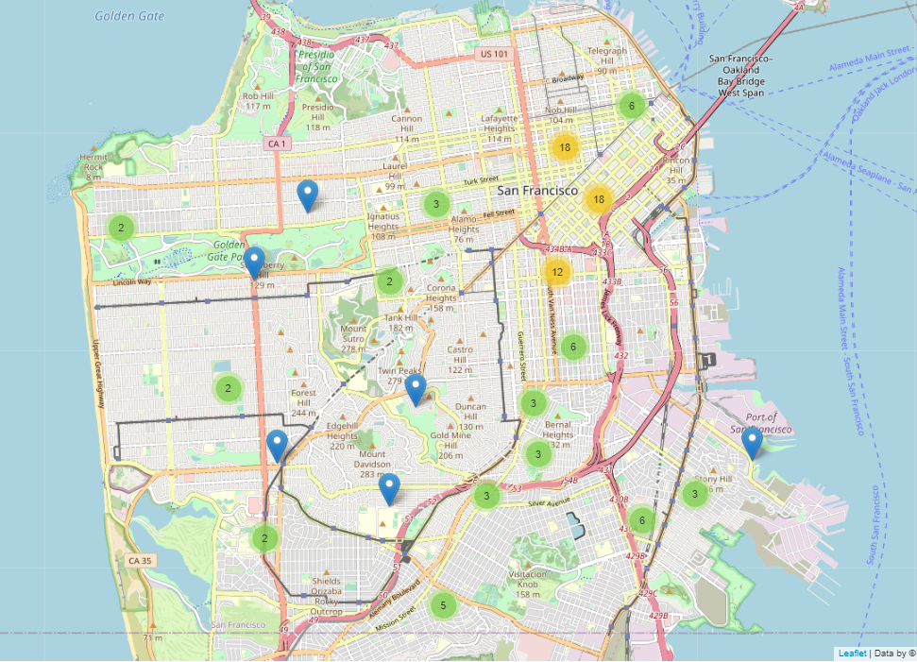
Grouping the markers into clusters to remedy the congestion

Slide 11
Results and discussion
The dataset imported was very large. However, it may have posed a problem during the mapping given the 100 sampled were also still congested.
Data clustering was efficient in minimizing the problem of congestion on the mapped crimes.
Global clusters applied were able to indicate the number of crimes represented by each cluster on the map upon zooming
Tylor street and its neighborhood are prone to crimes compared with other areas.
Burglary and Vandalism were the highest recorded incidences along Tyler street and its neighborhood.

Slide 12
Conclusion
More Police officers should be deployed around Tyler street and its neighborhood to minimize crime incidences.
The data used was just a sample therefore may not reflect the current situation in the study area.
The study recommends employment of other robust techniques that would highlight causes of increased crime rates in some areas compared to others in the study area.
Some codes applied in the python may have changed following recent updates in some apps or plugins on the environment.

Slide 13
Acknowledgment
I would like to thank Coursera and IBM teams for their generous scholarship in studying this professional course and realizing a step into a field I am passionate about. This course was great with practical applications and hands on experience that ensure you understand each lie of code you write and what its execution would result. I encourage anyone interested in data science without any knowledge of programming to take this course as your starter pack.

Slide 14
Thank you

